Slide 1


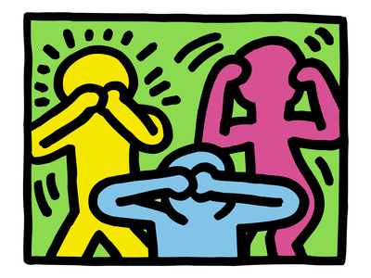
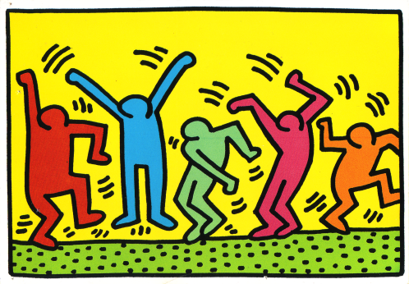
Business Ethics for Pharma and Device Companies
Marc Le Menestrel, PhD
Associate Professor, University Pompeu Fabra (Barcelona, Spain)
Visiting Professor of Ethics, INSEAD (Fontainebleau, France)
Seventh International Pharmaceutical Compliance Congress
Madrid – May 2013

Slide 2



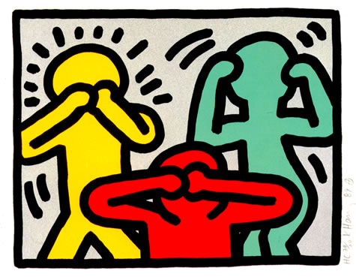
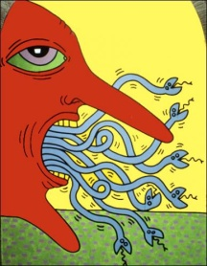
Structure of content
Thinking about ethics
Thinking about ethics
Acting with/without ethics
ethics
Talking about ethics
ethics

Slide 3
Fundamental Questions
Is business ethical?
Is the pharmaceutical industry ethical?
Is your company ethical?
Are you ethical?

Slide 4
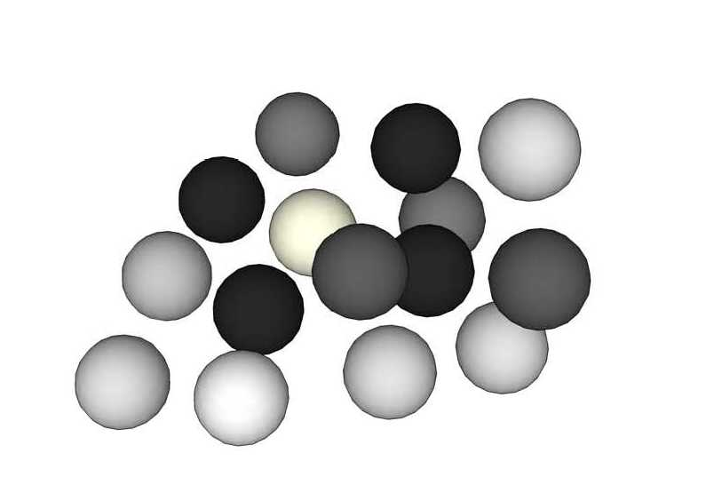
Which white spheres?
Marc Le Menestrel, UPF & INSEAD

Slide 5
Thinking Ethics as a Grey Zone
Looking at the bad side
Looking at the good side
You are honest
It feels bad
But you are more aware and anticipate ethical risks
You feel good, full of energy
You may not be as credible as you want
And you may be blind to ethical risks
Purely
unethical
Purely
ethical
Our ethical judgments are bounded and biased by our emotions, our self-interest, our mental habits and self-image, our cultural context, our work environment and our power to act.
This phenomenon is not necessarily intentional, but it can have significant consequences.
We can develop, refine and structure our ethical consciousness. It requires to open our mind and be able to think beyond the justification of our ethical opinion.
It necessitates training and effort, outside our zone of comfort
Marc Le Menestrel, UPF & INSEAD

Slide 6
Enlighten your Ethical Blindspot
To which extent is this bad?
To which extent is this good?
Which stakeholders can be harmed? How much? When?
Can this be wrong? Against compliance? Against the law? Against some ethical principle? What if everyone does the same? All the time?
Am I having bad feelings? A sense of discomfort? An early warning signal inside?
Would this be better kept secret? Is this taboo? Could it be publicly known?
Which stakeholders can benefit? How much? When?
Is this right? Does it comply? Is this legal? Does it respect the spirit of the law? Is this respecting ethical principles, code of values? Can this be universalized?
What good feelings do I have? What virtue do I incarnate? Why is this respecting my personal integrity?
What would I like to be known? To be transparent? is transparent?
Marc Le Menestrel, UPF & INSEAD

Slide 7
Transformer le désir de complétion: être le premier qui va transformer sa multinationale en une entreprise socialement responsable. Le « super héro » dont on se souviendra dans l’histoire.
Comment son paradigme oblige l’entreprise à rentrer dans une logique de lutte qui lui coûte très cher?
Which laws are applicable there?
Unethical Issues in the pharmaceutical industry
Which opportunities to make profit and where?
Exploratory Research | Pre-clinical development | Clinical development | Registration | Procurement and manufacturing | Marketing | Distribution and Phase IV | Recycling
R&D | Laboratory development |  | Commercialization
Research | Animal testing Clinical trial |  | Drug registration Mass production Marketing & post-marketing |  |  |  | Drug recycling
Control of publication and research outcomes R&D for orphan drug and neglected diseases R&D for developing countries diseases | Clinical trial disclosure Respect for persons, beneficence and justice Children and women in clinical trial Clinical trial in developing countries Animal welfare |  | Patent protection and extension with lobbying Political contributions to promote legislation friendly drug to manufacturers Drug safety in manufacturingm distribution and post-marketing processes Pricing for medicine Influence over professionals Labeling and promotional information and material Drug pricing transparency |  |  |  | Air emission Solid and hazardous waste Spill and release in water Hazardous material Water waste Biodiversity
Ethical consequences?
Source: Evaluation of CSE performance , Palazzo, G. et al, UNIL 2010

Slide 8
Compliance does not mean Ethics
ETHICS
Unethical
Ethical
1
2
Yes
COMPLIANCE
No
3
4
There are many ways for being compliant and unethical.
There are many ways to be ethical and not compliant.
Did you study them?
Marc Le Menestrel, UPF & INSEAD

Slide 9

Fundamental Question
Ethical Values
Less ethical
More Ethical
Better
Can you be ethical and rational?
Business-Interest
Worse
There is no point in talking about ethics in business if we don’t talk about how much it costs
Marc Le Menestrel, UPF & INSEAD

Slide 10
Economic Rationality
Ethical Values
Less ethical
More Ethical
Better
Rational
Financial Interest
Worse
Irrational
With this discourse, business should be ethical if and only if this serves its financial interest.
Taught all over the globe, it logically implies tragic consequences
Marc Le Menestrel, UPF & INSEAD
Notes:
Je rajouterai « business should be ethical if and only if this serves its financial interest », parce que je pense que c’est quand même un intérêt fondamental pour n’importe quelle organisation de vouloir le bien-être de la planète et de ses habitants et, comme tu le dis très bien, le problème c’est de confondre rationalité au sens large avec rationalité économique.

Slide 11
Idealist Compliance
Ethical Values
Less ethical
More Ethical
Better
Financial Interest
Irrational
Rational
Worse
Compliance is supposed to be an absolute criterion of choice.
In practice, we deny, hide and externalize the non-compliant decisions.
Marc Le Menestrel, UPF & INSEAD

Slide 12
Corporate Social Responsibility
Ethical Values
Less ethical
More Ethical
Better
Rational
Financial Interest
Irrational
Worse
Business interest and ethics are supposed to always combine. In practice, there are many situations in which ethics does not pay, and CSR may cover them up, for the best or the worse…
Marc Le Menestrel, UPF & INSEAD

Slide 13
Ethical Rationality
Ethical Values
From here, a reactive strategy mitigates ethical risks to avoid losing everything
Less ethical
More Ethical
Priority
to
interest
Better
Ideal
?
?
Priority
to
ethics
Worse
Irrational
From here, a proactive strategy should help you to reach the ideal
More than a discourse, ethical rationality teaches you to draw a line in the grey zone…
An art of surprise, ethics is a way to manage the unexpected.
Marc Le Menestrel, UPF & INSEAD

Slide 14
Fundamental Questions
Who do you trust enough to talk honestly?
By whom do you want to be trusted?

Slide 15
Credibility & Trust
Ethical questions are value-loaded, emotional and can be dishonestly biased towards the unethical side.
Ethical denials and justifications may nurture negative emotions in others.
Ethical answers which strongly ascertain the ethical side are not necessarily perceived credible.
Ethical answers which demonstrate awareness and consciousness of the unethical side, as well as pro-activeness towards the ethical side may enhance sincerity and trust.

Slide 16
Conclusions
Ethical thinking occurs in a uncomfortable grey zone.
Are you ready to enumerate all the things that you do wrong?
    You will be fully empowered to analyze the problems
Ethical action is about drawing a line in the grey zone.
Do you know the values for which you are ready to sacrifice some perceived business interest?
    You will generate resources to invest in a proactive ethical culture
Ethical credibility & trust requires to be honest about bad aspects.
Are you ready to discuss your unethical side?
    You will create an alliance of people prepared to help you

Slide 17

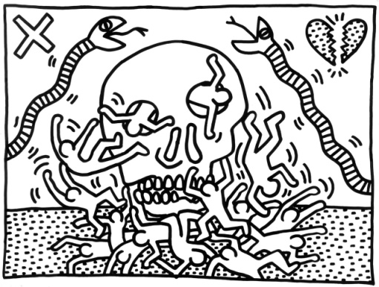
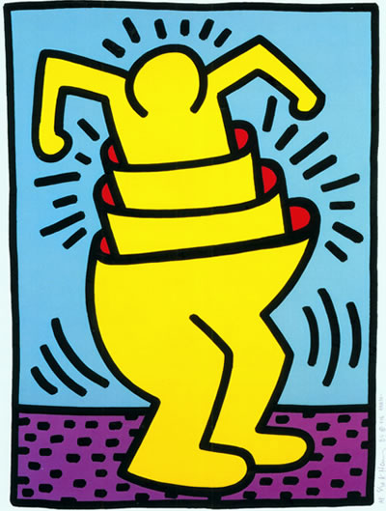
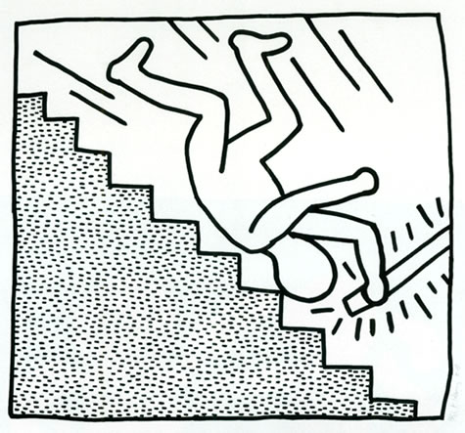
Thank you
Artwork Keith Haring

