Slide 1
International Business Policy An Ethical Perspective
Business and Global Environmental Issues:
The oil industry and climate change

Slide 3
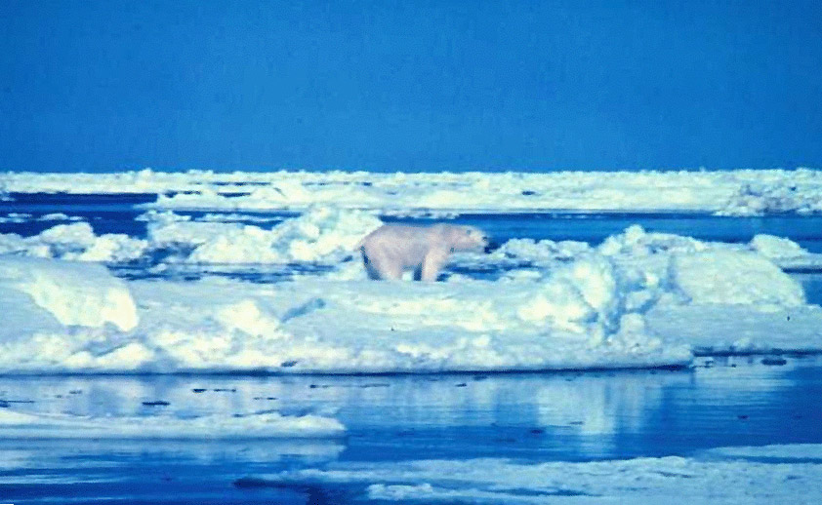
Climate change

Slide 4
The Oil Industry and Climate Change
In the mid 90s, within major oil companies
Emissions of CO2 were recognized as a potential determinant of global warming

Slide 5
Words from the Intergovernmental Panel on Climate Change (IPCC)
“The balance of evidence suggests that there is a discernable human influence on global climate”
IPCC Second Assessment Report, 1995
“The Earth’s climate system has demonstrably changed on both global and regional scales since the pre-industrial era, with some of these changes attributable to human activities.”
IPCC Third Assessment Report, 2001

Slide 6
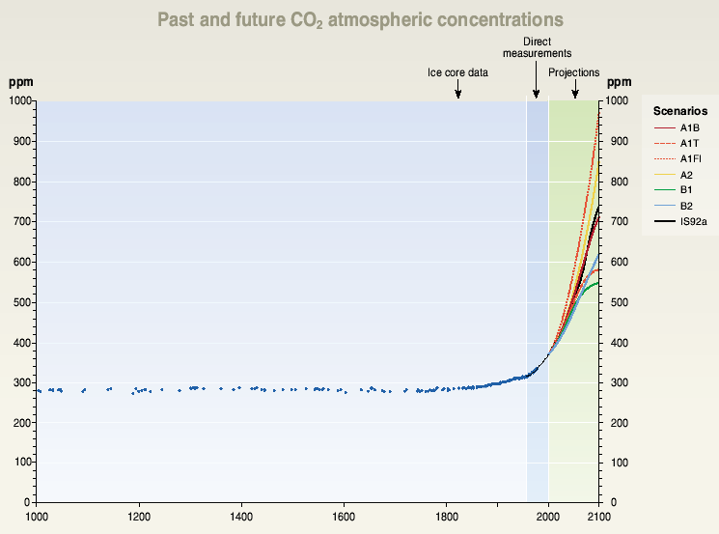
Build-up of CO2 in the atmosphere
Source: IPCC, TAR, 2001

Slide 7
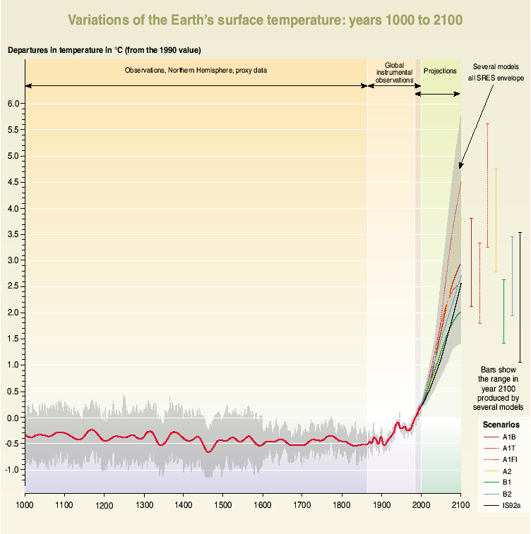
Variations of the Earth’s surface temperature: years 1000 to 2100
Departure from 1990 value
Grey = uncertainty (95% conf. Limit)
Before 1860: proxies (tree rings, corals, ice cores & historical records) 50 years average
From 1860 to 2000: observations
50 then 10 years average
From years 2000 to 2100 projections
Source: IPCC, TAR, 2001

Slide 8
Climate Change Effects
Increase of Global Mean Surface Temperatures
Irreversible and rapid Climate Change
Sea Levels Rises
Increased occurrence of Extreme Weather Events
Disruptions in agriculture
Spread of Tropical Diseases
Population Migrations
Disappearance of ecosystems and species that are unable to migrate
…
Impacts are expected to be mostly
negative, dramatic, world scale, irreversible

Slide 9
The Oil Industry and Climate Change
In the mid 90s, within major oil companies
Regulation of CO2 emissions was perceived as a threat to the growth of fossil fuels as a source of energy

Slide 10
Climate Change Causes
Gas
Sources in Industrialized Countries (1990)
Radiative Forcing
CO₂
Fossil Fuels combustion >95%
Industrial Processes 2-3%
70-72%
Methane (CH₄)
F. fuels prod., distri. & combu. ~ 33%
Agriculture ~ 33%
Waste ~ 33%
21-22%
N₂O (peroxide d’azote)
Agriculture 40 %
Fossil Fuels combustion 20-25 %
Industrial Processes 30-35%
6-7%
HFCs, PFCs, SF6
Industrial Processes; Industry; Consumers (e.g. A/C)
< 1%
strong growth

Slide 11
The Threat to Oil Industry
Potential increase of the liabilities attached to the product
Increase of price due to internalization of the costs of externalities
Reduced access to resources
Entrance of competitive sources of energy
Diminishing demand
Reduced social acceptance of the product and of the industry

Slide 12
The Oil Industry Dilemma
Better business
environment
Without regulation
Worse business
environment
With regulation
Prima facie, the regulation of CO2 emissions presents a dilemma to the oil industry
There is an ethical dimension because the emissions of CO2 is perceived as threatening the well being of humanity

Slide 13
Exxon’s strategy: Fight against action
Goal: Prevent –or delay– policy action on climate change
Tactics:
Denying the dilemma
Contesting and influencing the science
Influencing public perceptions
Impairing policy processes

Slide 14
A word from Exxon’s CEO
“Although the science of climate change is uncertain, there’s no doubt about the considerable economic harm to society that would result from reducing fuel availability to consumers by adopting the Kyoto Protocol or other mandatory measures that would significantly increase the cost of energy. Most economists tell us that such a step would damage our economy and almost certainly require large increases in taxes on gas and oil. It could also entail enormous transfers of wealth to other countries.”
ExxonMobil CEO and Chairman, Lee Raymond, 2001

Slide 15
Exxon’s progression of statements
Climate change is not happening
The science of climate change is uncertain
Climate change is not human-induced
Climate change will not necessarily be bad
Now is not the good time to act
Policies under discussion are not the good way to tackle with the issue
It’s too late to act

Slide 16
Exxon’s deeds (some…)
Key member of Global Climate Coalition:
Lobby US Congress against Kyoto (E.G. Byrd-Hagel resolution)
Advertisement campaign: Kyoto unfair to US, Kyoto won’t work, economic doomsday
Political donations
Criticising and attacking IPCC science as uncertain and biased; financing ‘climate sceptics’
Economic arguments against emission reduction policies based on self-funded economic models
Telling developing countries that Kyoto will “strangle economic growth”

Slide 17
Tactics: Priority to Business
Denial of the unethical process;
Emphasis of the costs of sacrifice;
Search for industry coalitions;
Influence and distortion of scientific research;
Influence and subversion of political and international institutions;
Influence and manipulation of public opinion;
Confidentiality of strategic choices.

Slide 18
Priority to Business
Fight against regulation
(less ethical)
More profitable
consequence
-
+
Less profitable
consequence
Admit regulation
(more ethical)
Emphasizing the business consequences differential
Weakening the ethical differential
Confidentiality of the strategy – Bad faith communication
By giving priority to business, ethics becomes mainly an issue of public relation

Slide 19
TotalFinaElf’s strategy: Stay neutral
Goal: Be prudent, stay focus, free ride
Tactics:
Accept the possibility of a dilemma
Do not counter public science
Announce good intentions
Develop political connections

Slide 20
A Word from ELF CEO
« The Elf Aquitaine Group is ready to commit to a reduction of 15% of its [CO2] emissions in 2010 ».
Philippe Jaffré, 1997

Slide 21
BP’s strategy: Proactive
Goal: Taking advantage of the situation
Tactics:
Facing the dilemma and try to address it
Acknowledging the science
Communicating on their new strategy
Participating in policy process

Slide 22
A word from BP’s CEO
“We must now focus on what can and what should be done, not because we can be certain climate change is happening, but because the possibility can’t be ignored. If we are all to take responsibility for the future of our planet, then it falls to us to begin to take precautionary action now.”
BP Chief Executive, John Browne, 1997

Slide 23
BP’s progression of statements
Society cares (recognition of a societal concern)
We are causing social damage (acknowledgement of responsibility)
We will modify our behaviour
… and nevertheless remain profitable

Slide 24
BP’s deeds or promises (some…)
Left the Global Climate Coalition for the Pew Center on CC’s business council
Reducing BP’s internal emissions (including setting up internal emissions trading scheme)
Focus on energy conservation (internally and with consumers)
Investment in solar energy business
Promoting the use of flexibility mechanisms

Slide 25
Tactics: Priority to Ethics
Acknowledgment of the unethical process;
Mitigation of the cost of sacrifice;
Emphasis of long term benefits;
Strategic re-positioning;
Search for differentiation and competitive advantage;
Ambiguity of the sacrifice;
Transparency of strategic choices;
Making amends?

Slide 26
Priority to Ethics
Fight against regulation
(less ethical)
More profitable
consequence
+
-
Less profitable
consequence
Admit regulation
(more ethical)
Weakening the business consequences differential
Emphasizing the ethics differential
Transparency of the strategy – Ambiguity of good faith
By giving priority to ethics, it becomes a factor of strategic management

Slide 27
Discussion
Is there a real difference between the three strategies?
In terms of Business?
In terms of Ethics?
In terms of Management?

Slide 28
Exxon vs BP vs Total (Share Price 01/01/97 to 01/09/01)

Slide 29
In terms of Ethics
What happens to the environment if oil companies are let to run the world?
What happens to society?
What happens to business?
What will happen to you?
The example of Oil Industry and Climate Change raises the fundamental question of the role of business:
Should society serves business or business serve society?

Slide 30
In terms of Management
Would you prefer to work for ExxonMobil, for Total, or for BP?

Slide 31
An Art of Surprise?
Unexpected Costs of Fighting against Society
Society imposes increased accountability and liability;
Value of brand name;
Costly regulations;
Increased organizational inertia due to confidentiality;
Reduced internal motivation and trust due to deceptive public communication.
Unexpected Benefits of Aligning with Society
Alignment with society may reduce liability;
Preserved brand name;
Exploration of alternative profitable business consequences;
First mover on new business opportunities;
Organizational learning process;
Increased internal motivation and trust.

Slide 32
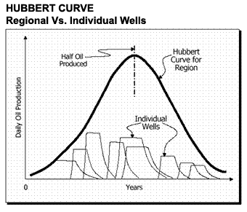

Slide 33
The End of the First Age of Oil?

Slide 35
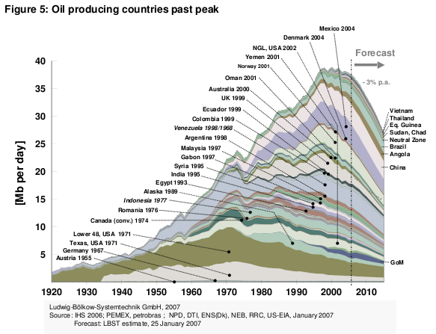

Slide 36
The Future of the World
Are you aware of any evidence that our way of life is not sustainable?
and may come to an end?
How do you feel about this?

Slide 37
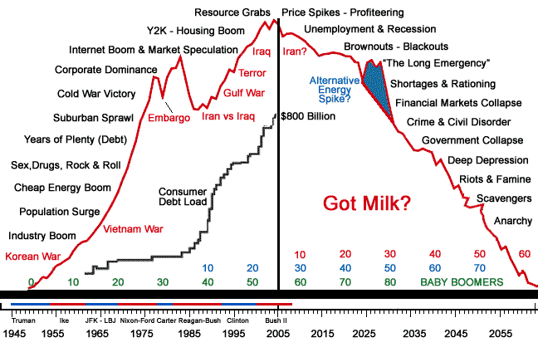
The Rise of Fear?

Slide 38
Feeling Powerful
I will try to have enough strength to change the things that I can change,
I will try to have enough peace to accept the things that I cannot change,
I will try to be wise enough to see the difference between the two.

Slide 39
The Present of Your Self
Do you really need to believe that our way of life has to remain as such in order to accomplish yourself?
Can you dream of a better future?
Then, you can look at the evidence showing that our way of life comes to an end and find there energy to construct a better future

