Slide 1
Ethics and Rational Behavior
Marc Le Menestrel
Associate Professor, UPF, Barcelona
Visiting Professor of Ethics, INSEAD marc.lemenestrel@upf.edu - marc.lemenestrel@insead.edu
Notes:
Quote Poincarre
Balance: questions, opinions, jugements
Niveau d’enseignement pour les top managers

Slide 2
Session’s Questions
How do we know something/someone is (un)ethical?
How do we act (un)ethically?
How do we communicate (un)ethically?

Slide 3
Are governments ethical?
Is Business ethical?
Are you an ethical person?

Slide 4
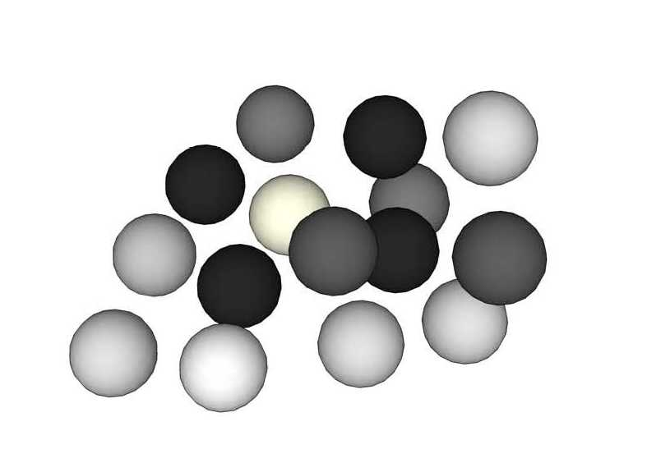
Select the white spheres:

Slide 5
Thinking Ethics as a Grey Zone
Looking at the bad side
Looking at the good side
You feel good, full of energy
You may not be as credible as you want
And you may be blind to risks
You are honest
It feels bad
But you are more aware and anticipate
Purely
unethical
Purely
ethical
Our ethical judgments are bounded and biased by our emotions, our self-interest, our mental habits and self-image, our cultural context, our work environment and our power to act.
This phenomenon is not necessarily intentional, but it can have significant consequences.
We can develop, refine and structure our ethical consciousness. It requires to open our mind and be able to think beyond the justification of your ethical opinion.
It necessitates training and effort, outside our zone of comfort
Marc Le Menestrel, UPF & INSEAD, for

Slide 6


Slide 7
Enlightening your Ethical Blindspot
To which extent is this unethical?
To which extent is this ethical?
Which stakeholders can be harmed? How much? When?
Can this be wrong? Against compliance? Against to law? Against some ethical principle? If everyone does the same? All the time?
Am I having bad feelings? A sense of discomfort? An early warning signal inside?
Would this be better kept secret? Is this taboo? Could it be publicly known?
Which stakeholders can benefit? How much? When?
Is this right? Does it comply? Is this legal? Is this respecting ethical principles, code of values? Can this be universalized?
What good feelings do I have? What virtue do I incarnate? Why is this respecting my personal integrity?
What would I like to be known? To be transparent? is transparent?
Here, you face the dilemma
Here, you justify your interest

Slide 8


Slide 9
Some Ethical Questions
Are you an ethical manager?
Do you work for an ethical company?
Is it ethical to close a profitable plant?
Is it ethical to influence a government?
Is it ethical to compromise on the safety of a product?
Is it ethical to shape customers desires?
Is it ethical to obey your boss?
Is it ethical to work as hard as possible?
Is economic growth ethical?
Is sustainable development ethical?
Can you analyze the YES and NO answers for each of these question?

Slide 10


Slide 11
Some Ethical Questions
Are you an ethical manager?
Do you work for an ethical company?
Is it ethical to close a profitable plant?
Is it ethical to influence a government?
Is it ethical to compromise on the safety of a product?
Is it ethical to shape customers desires?
Is it ethical to obey your boss?
Is it ethical to work as hard as possible?
Is economic growth ethical?
Is sustainable development ethical?
Can you analyze the YES and NO answers for each of these question?

Slide 12

Economic Rationality
Interest of the consequence
The rational actor (you, a team, a company, a state)
1. Anticipates the consequences of his actions
2. Evaluates these consequences according to his interest
3. Chooses the action that leads to the best consequence.

Slide 13
Would you act against your self-interest?
Against the interest of others
In your own
interest
Against your own
interest
you
In the interest of others
Could such a dilemma occur?
What would you do?
Why?

Slide 14
Would others act against their self-interest?
Against the interest of others
In his/her own
interest
Against his/her own
interest
Someone else
In the interest of others
Could such a dilemma occur?
What would another do?
Why?

Slide 15
What Should you do?
Ethics vs. Interest
Ethical Values
Less ethical
More Ethical
Better
Interest
Worse
There is not much point in talking about ethics if we don’t talk about how much it costs

Slide 16
First Discourse: Economic Rationality
Ethical Values
Less ethical
More Ethical
Better
Rational
Interest
Worse
Irrational
Interest is supposed to be the sole and unique criterion of rational choice. In practice, we deny, justify and externalize the unethical side of our action

Slide 17
Second Discourse: Idealism
Ethical Values
Less ethical
More Ethical
Better
Interest
Irrational
Rational
Worse
Ethical values, and in particular compliance, are supposed to be an absolute criterion of choice. In practice, we don’t necessarily want to sacrifice our interest

Slide 18
Third Discourse: Corporate Social Responsibility
Ethical Values
Less ethical
More Ethical
Better
Rational
Interest
Irrational
Worse
Interest and ethics are supposed to always combine. In practice, there are many situations in which ethics does not pay, and CSR may cover them up, for the best or for the worse…

Slide 19
Ethical Rationality is Open
Ethical Values
Less ethical
More Ethical
Priority
to
interest
Better
Ideal
Interest
Priority
to
ethics
Worse
Irrational
Rational choices between interest and ethics are often kept hidden, but they are the most difficult:
We can rationally give priority to interest, and sacrifice ethics
We can rationally give priority to ethics, and sacrifice interest
Marc Le Menestrel, UPF & INSEAD, for

Slide 20
Priority to Interest: A Reactive Attitude
Less Ethical Action
Higher interest
???
More Ethical Action
Lower interest
We act unethically because we think it is in our interest.
We resist admitting the ethical issue (denial)
We insist on our good faith (justification)
We discard the alternative and tend to blame others (externalization)
We face ethical risks. In the worst case, we lose on both ethics and interest
Marc Le Menestrel, UPF & INSEAD, for

Slide 21
Priority to Ethics: A proactive Attitude
Less Ethical Action
Higher interest
???
More Ethical Action
???
Lower interest
We resist acting unethically because we want to respect our values
We acknowledge the ethical dimension (Awareness)
We anticipate the ethical risks (Prudence)
We imagine an opportunity (Vision)
We face economic risks. In the best case, we win on both ethics and interest

Slide 22
Dynamics Analysis
If you are in the ideal position, you may not be lucky for very long
Increasing demands (legal, social)
Credibility ambiguous
Contentment, lack of vigilance
Unawareness, rationalization
Priority
to
interest
Ideal
Lack of transparency
Legal pressure
Liabilities
Bad Reputation
PR costs
Negative motivation
Managerial inertia
Transparency
Social involvement & support
New scope of activities
New business processes
Long term thinking
Strategic investment
Positive motivation
Learning process
Priority
to
ethics
Irrational
If you give priority to interest, you will need reactive strategies to survive
If you give priority to ethics, you may find help for your proactive strategies

Slide 23
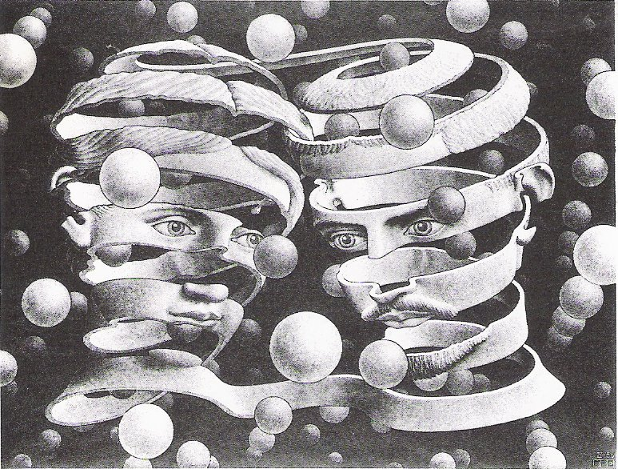

Slide 24
How to Communicate (un)ethically?
Ethical questions are value-loaded, emotional and can be biased towards the unethical side.
Ethical denials and justifications may nurture negative emotions in others.
Ethical answers which strongly ascertain the ethical side are not necessarily perceived credible.
Ethical answers which demonstrate awareness and consciousness of the unethical side, as well as pro-activeness towards the ethical side may enhance sincerity and trust.
Marc Le Menestrel, UPF & INSEAD, for

Slide 25
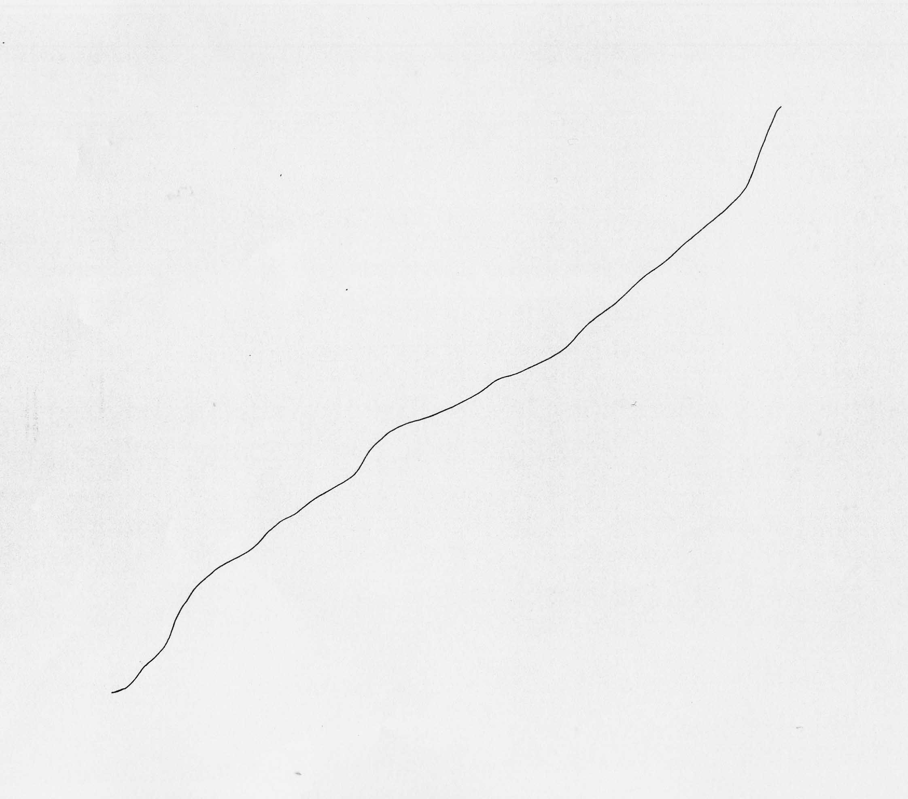
Joan Miro, 1968

Slide 26

Thank you!

