Slide 1
Financial and/or Ethical Crisis: Values and the Future of Business
Marc Le Menestrel

Slide 2
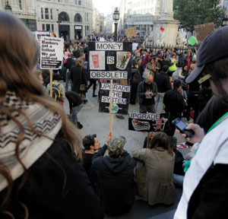
2011 Wall Street protests strikingly resembles the situation describes in this 2008 case

Slide 3
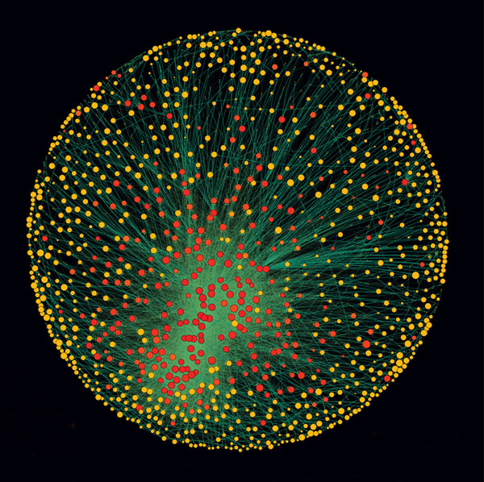
The Network of Global Corporate Control (from Vitali et al., PLoS ONE, 2011)

Slide 4
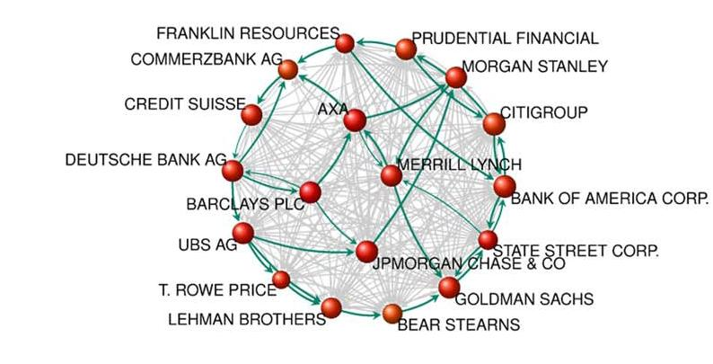
A Zoom on the network of major actors in the financial sector (Source: Vitali & al., PLoS ONE, 2011)

Slide 5
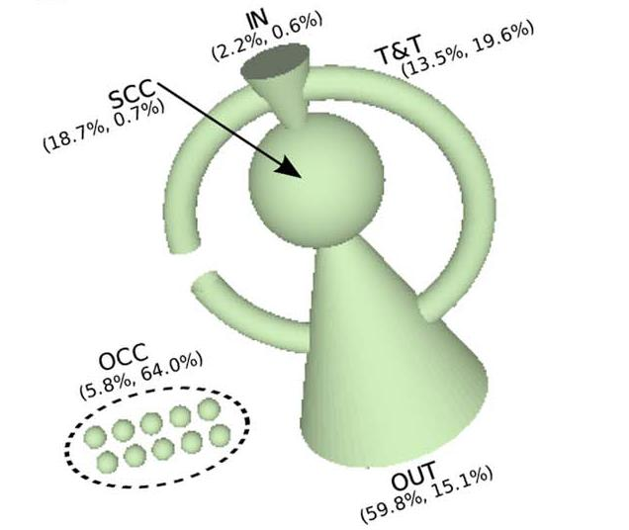
The Topology of Global Corporate Control: nearly 40% of the control over the economic value of corporations in the world is held by a group of 147 corporations in the core, which has almost full control over itself. (Source: Vitali et al., PLoS ONE, 2011)

