Slide 1
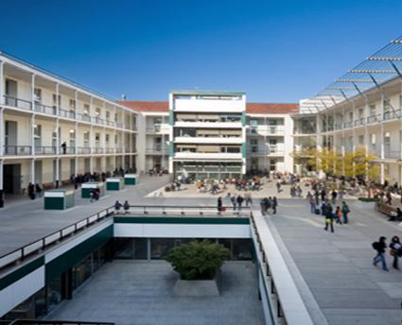
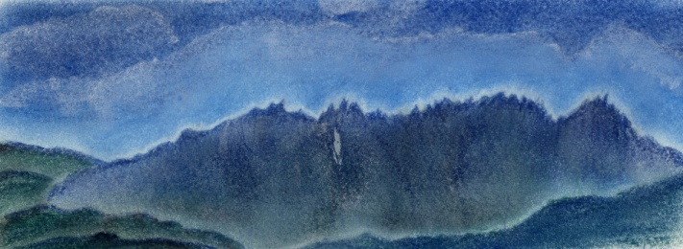
OPEN MEETING
“Strategy” Teaching at UPF
28 November 2011
« TO MEET AND TO SHARE »
15.00-18.00
A Changing World?
Positive conversations about us and our teaching
The intention of this meeting is to meet and share openly about our teaching at UPF.
We will take the time to meet, to present what we are teaching, to share how we like to do it, and to discuss where we aim to go.
If we succeed, we will know better what makes our classes relevant and how they make a difference, if any. We will have a good time together and will feel more powerful to be the teachers we want to be.
The meeting is open to all teachers in the area “Strategy” at UPF. It is not a convocation or hopefully not one more pressure on your busy calendar: it is an open invitation to meet and share.
If you plan to come, think about:
Content:
- What do you hope your students will remember after your classes?
Passion:
What is your most preferred manner to teach a class?
Relevance:
- How would you like your teaching to make a difference?
“At UPF, INSEAD or Cambridge, in Europe, US or China, to undergraduates, MBAs or senior executives, I have nurtured my passion for teaching by learning to be at the service of my students. As Area Coordinator of the Strategy Area at UPF, I try to be at the service of you, my colleagues, and I am always keen to learn about you and your pedagogical journeys. With this meeting, I want to give you the opportunity to meet all together in an open, positive and non-strategic manner.”
Marc Le Menestrel
Notes:
Jose Luis Marin, until 17.00
Santoshi Sengupta
Gaël Le Mens
Yuliya Snihur
Susana Domingo
Oriol Palom
Minna Paunova
David Rodriguez, until 16.00

Slide 2
Insights from the First Meeting
It was as a very international team from Mexico, Bulgaria, Ukraine, India, Catalunya or France that met in a circle, expressing the desire to become at the service of each others and improve our teaching experience at UPF.
We raised big questions, like the one about the direction, vision, ambition of the UPF pedagogical mission but also small questions, like how to contact the Secretariat to make sure a particular class will take place in a room with free chairs, which can be very useful for a participative seminar.
We shared equally big and small answers, about the balance between teaching content and students’ motivation, about our passion but also our sense of being exhausted after five repeated seminars, and of course about the ways to give more relevance to our work. Below is an attempt to share a few insights:
• The ambition of our teaching excellence should come from us: we can develop our vision and if we do it together, we are more likely to sustain a meaning and a synergy;
• The Bolonya process is very much aimed at committing the students to the learning process, this is a great opportunity to modernize our teaching methods and experiences;
• Oxford has a vision of “broadening students’ minds”. What is ours?
• Having a theme that reflects the key message we want to share with students as a person helps to give meaning and relevance to a teaching experience. Examples were given, like one of us who has given a twist to his teaching around the theme of Power, thus making his teaching much more interesting, for the students but also for himself;
• We also shared about themes like responsibility, cooperation or sustainability, which are nice complementing themes given the somehow competitive orientation of economics education at UPF;
• We should not merely compete with books, but add something unique that makes students willing to come to class, something coming from us as a person and often a particular expert in some subjects
• We should promote intercultural interactions and push students to participate more: it works!
• On-going assessment can make much more sense for courses around strategy, where a final exam is sometimes of little learning value for the students. It can be possible to have a course without final exam if evaluation is truly continuous;
• You can make sure students are prepared by quizzing them at every class! Sometimes, grading of these daily assignments can be on a fail/pass basis, or over 5 points with a clear structure;
• Having bad evaluations as a teacher can be tough and question ourselves. There is a motivation to improve but a distance to take in order not to be prisoners of evaluations ;
• There are many ways to include small activities, games and case-studies in order to learn by doing and develop experiential aspects of the learning. In fact, experience is the only way to attain the identity, which takes part of the development process proper to excellent management education;
• Students love to think and work when we succeed in making the work relevant to themselves;
• As professors, we can relate with what we like and are interested in. It is impossible to be an interesting teacher if we are not interested ourselves;
We can learn to manage tension/controversy during class that can generate discussion. If it does not, the teacher can play roles (devil's advocate?) to elicit more participation;
Importance of self-reflection exercises for students (i.e. a simple "what did you learn" at the end of each class);
We need to experiment/change sessions that proved to be boring/unsuccessful in the past;
We can link with other initiatives, such as http://wedreambusiness.org/
• We can dare to be more emotionally engaged and engage more the students. Keeping in touch with others ensures we are not completely off-track though;
• Clarifying our take-away messages helps to clarify the content of our courses;
• There are various solutions for dealing with the copyright issues of case-studies but it seems some clarity is needed there, maybe from the dean office?
• It would be great that professors know clearly who their administrative assistant at the secretariat is. Maybe Marc could coordinate that better?
• There are many practical tricks that are worth being shared and we should increase our ability to exchange them among us
We could open a forum to discuss among us, post useful practical advices and keep the ball rolling;
Looking at the feedback from attendants, the meeting was successful and could be repeated!
Notes:
Jose Luis Marin, until 17.00
Santoshi Sengupta
Gaël Le Mens
Yuliya Snihur
Susana Domingo
Oriol Palom
Minna Paunova
David Rodriguez, until 16.00

Slide 3
Insights from the Second Meeting (Dec 21, 2011)
The second meeting established the pleasant, efficient and open spirit of what is a useful initiative to improve our teaching experience at UPF.
We welcomed in particular the presence of Oriol Palom, General Manager of IC3, who brought his expertise in Environmental Management to enrich our courses or seminars and raise their relevance. We also enjoyed the many ideas of Santoshi Sengupta, who demonstrated that we in Europe have to stay in touch with innovative techniques that are taught in Asia (she may share some of documents on the website). Last but not least, we were privileged to have the Dean of Faculty Vicente Ortun, coming in an open manner and giving us the feeling that what we are doing for us and our students also have a meaning for the institution.
We were practical and discussed the development of syllabi for teaching Strategy and also sharing some tricks to face the anxiety and stress that may accompany the start of a new teaching experience. The feedback indicates that the meeting was of great service in several aspects, but mostly with respect to getting students engaged... How do we boost participation, how to handle seminar sessions; the evaluation pattern and criteria of students during seminars; the importance of asking positive questions like "what did you like the best in the presentation?“; etc.
Below is a non-exhaustive list of learning that we took away:
First and foremost, in terms of managing student participation, I learned not be afraid of silence. As I have the tendency to start answering my own question after a mere 5-second lack of response from the audience, becoming aware of tactics to "manage" silence was most informative to me. Repeat the question, if necessary. Cold-call less attentive faces, if necessary... At the end, students learn more (and enjoy more) when they are pressed to convey their own thoughts, ideas and interpretations to others. As most of us know first-hand, we often get a thought only after having formulated it! (i.e., I was reminded of - and might introduce students to - Weick's famous aphorism "How can I know what I think until I see what I say?").
Another point that was raised and that would be quite useful for my classes has to do with structuring discussion in more unconventional ways. For example, instead of asking individuals to directly answer a given question, the question can be posed to small groups (of 2-3 students) for discussion. Then, these groups share with the class their take-aways from the group discussion. This technique is more appropriate for larger groups. I am sure that some colleagues leading seminar classes found other suggested techniques more useful.
A related point had to do with engaging students in role-play. I have personally experienced resistance to role-play, but today I became aware of ways to compel students to get into character, so to speak.
"What have I learned" is evidently a good question to raise after case discussions and as part of assignments more generally....
Using slides to our best advantage was another useful take-away from today's meetings. I will re-think the information I present on the slides to be sure that my lecture always goes beyond the slides, so that students are attentive.
Finally, the suggestion to look into alternative media for suggested readings (i.e., other than HBR, The Economist...) was of great help. I have already been considering some blogs on business, management and society, but I will also look into magazines such as Ode Magazine.
The teacher has to trust him/herself and be confident enough to be able to sustain silences, and to speak less during the class, letting students learn among themselves;
Group presentations can be concluded by asking the audience what they liked about the presentation;
Students are also responsible for the learning experience in class;
We can ask students to use name tags so as to develop the relation students-professors and encourage participation.
We could create a web resource to share various teaching material such as videos, games, ice breakers, etc. relevant for teaching strategy.
The forum could also be used to call for help or propose another Open Meeting!
Let’s nurture this on-going process for developing our teaching content, passion and relevance!
Notes:
Jose Luis Marin, until 17.00
Santoshi Sengupta
Gaël Le Mens
Yuliya Snihur
Susana Domingo
Oriol Palom
Minna Paunova
David Rodriguez, until 16.00

