Slide 1
Introduction:
Can You Be Rational and Ethical?
Marc Le Menestrel
marc.lemenestrel@upf.edu

Slide 3
Presentation of the course
Objectives
Methods
Participants
Content
Instructor
Evaluation

Slide 4
Objectives
To raise your awareness of issues faced by business with regard to society and the environment: the ethical issues
To help you dealing with ethical dilemmas
To increase your ability to see things “differently”
To learn from yourself, to learn from each other, and to develop your own questioning;
To share my enthusiasm in analyzing the relation between business and society in the century to come.

Slide 5
Methods
Readings (required)
Preparation essays
Case studies
Videos
Lectures (not too much)
Discussions (a lot)
Role play
Team work
Students presentation

Slide 6
Grading (1):
Preparation and Participation (60%)
Prepare a written answer to the question asked, showing:
  That you have read the material
  Your own reflection on the question
    Opinion
    Argument
    Beyond your argument
    Synthesis (so what?)
500 words maximum
Participation:
Jump in
Open your mind
Engage in dialogue with respect
Speak your own heart

Slide 7
Grading (2): WeDreamBusiness.Org (40%)
About a concept, an initiative, a behaviour or an actor that makes you dream because it successfully combines ethical values with the creation of business value.
Identified before Session 12
Uploaded before Session 17

Slide 8
Content
1 Introduction: Re-inventing Business?
2 Global Business and the Environment: Toxic Waste Trade
3 Corporate Social Responsibility: The Bhopal Gas Tragedy
4 Business, Ethics and Profit: Economic Approaches
5 Ethics and Behavior: Philosophical Approaches
6 Accounting Practices: The Enron Collapse
7 Goals, Processes and Rationality: A Parable and a Framework
8 International Business and National Politics: Royal Dutch/Shell in Nigeria

Slide 9
Content
9 Marketing Practices: The Tobacco Business
Business and Global Environmental Issues: The Oil Industry and Climate Change
Global Labor Markets: Child Labor in Asia
12 The Internet and Multi-jurisdictional Compliance: Yahoo! on trial
Communication in Ethical Crisis: Who Won the Danone Boycott?
Technological Risks: Monsanto and Genetically Modified Organisms
15 Banking in Crisis: A Day at the Big Bank
16 The Individual, Business and Corruption: The Changmaï Case
Students’ Presentations
Conclusion

Slide 10
Participants
What makes you exceptional: a key aspect of who you are
Your professional dream
Something (anything) that scares you
Something (anything) that you find wonderful

Slide 11

Instructor
I have done business
I have been teaching ethics in business over the last 10 years
I have been a rock-climber (and still…)

Slide 12
Are you a rational person?

Slide 13

Economic Rationality
Interest of the consequence
The rational actor (you, a team, a company)
1. Anticipates the consequences of his actions
2. Evaluates these consequences according to his interest
3. Chooses the action that leads to the best consequence.

Slide 14
Should you pollute less?
?
Continue Polluting
Maintain profits
Increase costs
Pollute less
According to economic rationality, you should not care about pollution beyond its expected negative impact on profits
What do you think our children think about this logic?

Slide 15
Should a company respect the law?
?
Violate the law
$ - 100 000
(including the fine)
$ - 150 000
Respect the law
What is the value of the law beyond the cost of the punishment?
Economic rationality answer is: zero!
What about the value of the spirit of the law?

Slide 16
Should our supply-chain respect Human Rights?
Violate Human Rights
Economic Value
Respect Human Rights
Of course, companies do respect human rights even if it is costly. Don’t they?

Slide 17
Should we say everything?
Hide the danger of a product or of an activity
Avoid regulation, Maintain a market growth
Favor regulation
Threaten a market growth
Reveal risks associated with a product or an activity
We often have an interest in hiding potential risks
Indeed, sincerity in communication can be very costly…
Where is the limit between confidentiality and transparency?

Slide 18
Will you avoid corruption?
Paying a bribe
Winning a contract
Losing a contract
Paying no bribe
Is corruption a necessary evil…
…of economic competition?

Slide 19
What about conflicts of interest ? (1)
Against the interest of the company
In your own
interest
Against your own
interest
In the interest of the company
Why would you act in the interest of the company?

Slide 20
What about conflicts of interest ? (2)
Against your own
interest
In the interest of the company
Against the interest
of the company
In your own
interest
Reciprocally, could a company be motivated to act in the interest of its employees even when this is against its self-interest?

Slide 21
Ethical Dilemmas: tough choices
Best interest of the actor
Less ethical
Worse interest of the actor
More ethical
An Ethical Dilemma arises when the action that best favors the interest of the actor conflicts with the action that is the most ethical

Slide 22
Would you lie for a monetary gain?
$ 1 000
Lying
$ 1
Telling the truth
According to economic rationality, you should lie whenever you have an interest to do so.
According to idealism, you should never lie.

Slide 23
First Discourse: Idealism
Ethical Values
Less ethical
More Ethical
Better
Self-Interest
Irrational
Rational
Worse
Some insist that ethical values should be the sole and unique criterion of choice

Slide 24
Second Discourse: Economic Rationality
Ethical Values
Less ethical
More Ethical
Better
Rational
Self-Interest
Worse
Irrational
Some insist that self-interest should be the sole and unique criterion of rational choice

Slide 25
Third Discourse: Corporate Social Responsibility
Ethical Values
Less ethical
More Ethical
Better
Rational
Self-Interest
Irrational
Worse
Some insist that interest and ethics always combine

Slide 26
My Point
These 3 discourses miss many of the most difficult choices managers face in real life
They are just discourses.
In action, ethical issues are much less simplistic…
I believe that most of our decisions, if not all, do include some dilemma between our interest and ethical values

Slide 27
Opening to Ethical Rationality
Ethical Values
Less ethical
More Ethical
Priority
to
interest
Better
Ideal
Self-Interest
Priority
to
ethics
Worse
Irrational
Rational choices between interest and ethics are often kept hidden.
They are the most difficult. How to act in front of these dilemmas?
Marc Le Menestrel, UPF & INSEAD, for

Slide 28
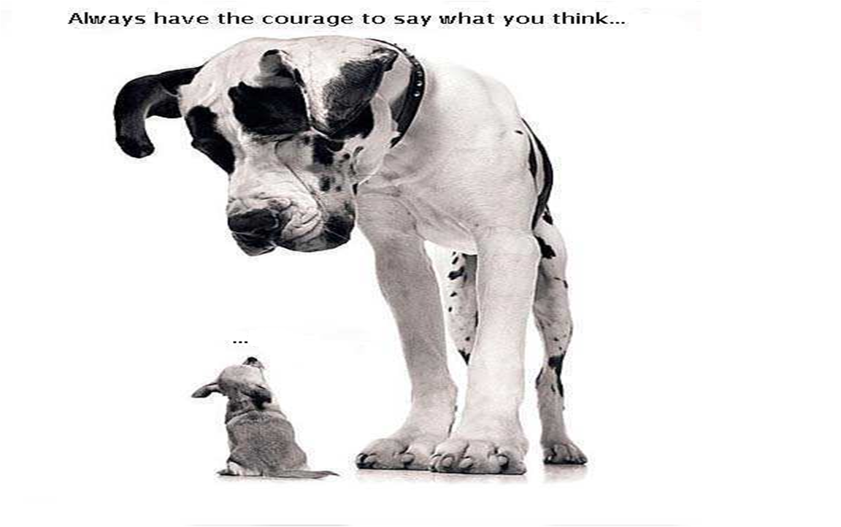

Slide 29
The Nature of Ethical Judgment
Is business ethical?
Are you an ethical person?

Slide 30
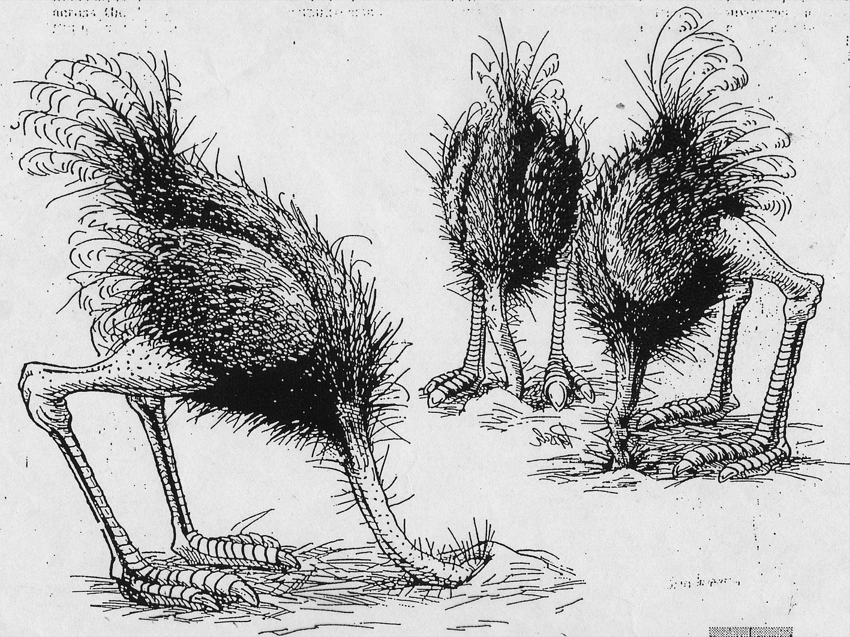

Slide 31
Thinking Ethics as a Grey Zone
Looking at the bad side
Looking at the good side
You feel good, full of energy
You may not be credible
And you may be blind to risks
You are honest
It feels bad
But you are more aware and anticipate
Purely
unethical
Purely
ethical
Our ethical judgments are bounded and biased by our emotions, our mental habits and self-image, our cultural context, our work environment, our self-interest and our power to act
This phenomenon is not necessarily intentional, but it can have significant consequences.
We can develop, refine and structure our ethical consciousness. It requires to open our mind and to be able to think beyond the justification of your ethical opinion.
It necessitates training and effort, outside our zone of comfort
Marc Le Menestrel, UPF & INSEAD, for

Slide 32
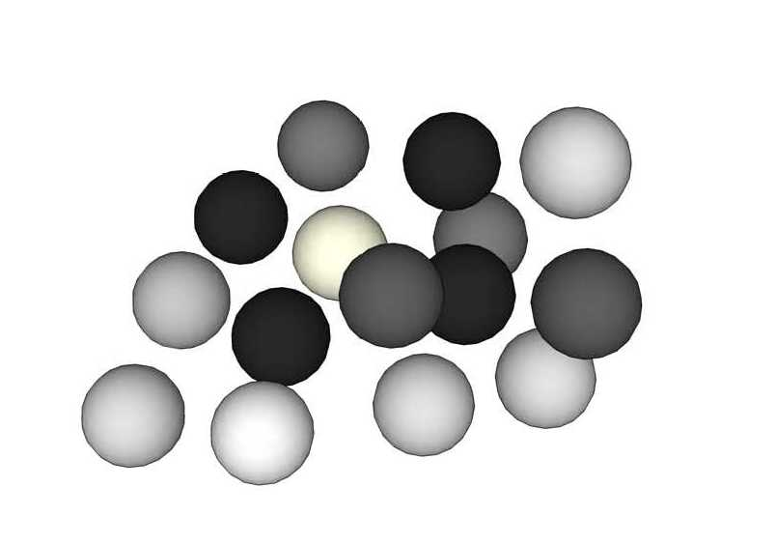
Which of these Spheres are White?
Some are still darker than others…

Slide 33
Dual & Systematic Ethical Analysis
To which extent is this unethical?
To which extent is this ethical?
Can it harm?
Which stakeholders?
How much? When?
Can this be wrong?
or unfair? According to laws & regulations? To some ethical principle? If everyone does the same? All the time?
Does it feel bad?
A sense of discomfort? An early warning signal inside?
Would this be better kept secret? Is this taboo? Could it be publicly known?
Can it benefit?
Which stakeholders
How much? When?
Can this be right?
and fair? Is this legal? Is this respecting ethical principles, code of values? Can this be universalized?
Does it feel good?
What virtue do I incarnate? Is this respecting my integrity?
What would I like to be known? What is transparent?
Marc Le Menestrel, UPF & INSEAD, for

Slide 34


Slide 35


Slide 36


Slide 37
Beyond the first layer of discourses
Explicitly and/or implicitly, you may be taught that interest is the (only) criterion for rationality
Lying, deception, pollution, human rights violations, law infringement, corruption, exploitation, etc are issues difficult to address during a MBA
We do not choose the less ethical action rationally because it is a pleasure, but because we have an interest in doing so
When we do so, we are inevitably tempted to deny the dilemma, the justify our action, and to pass the responsibility to others

Slide 38
Can you be rational and ethical?
Yes, but not always
Sometimes, a rational actor will sacrifice ethical values for the sake of his interest
Sometimes, a rational actor will sacrifice his interest for the sake of ethical values
Choose the one you want to be

Slide 39
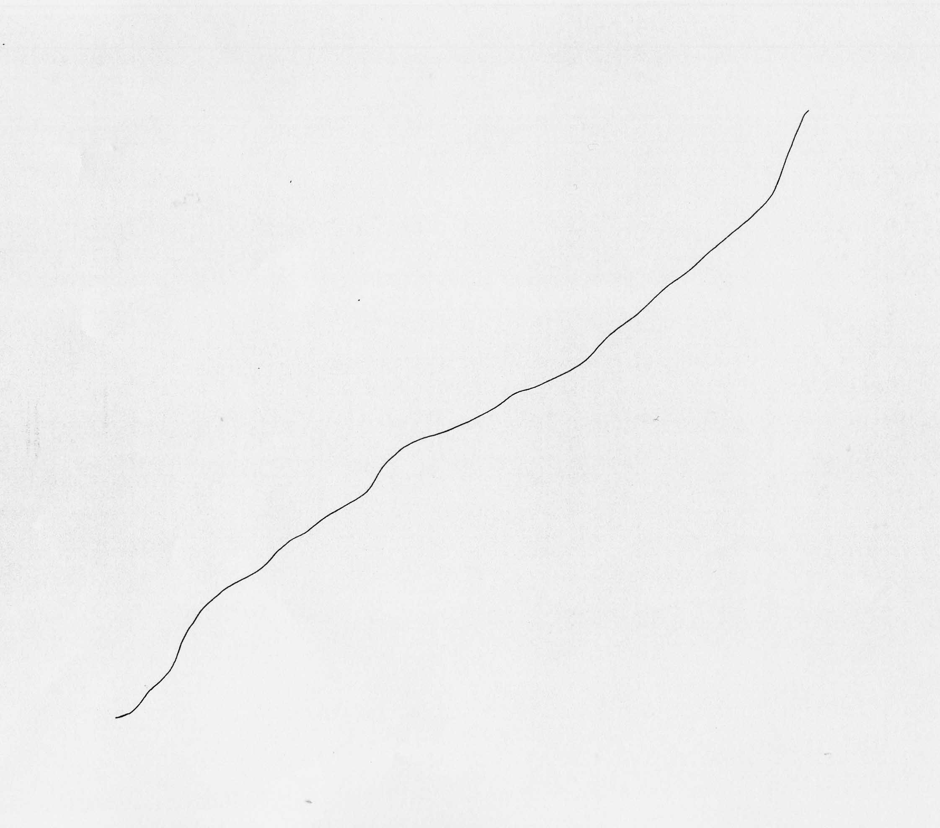
Joan Miro, 1968

