Slide 1

Master in Health Economics and Policy
Ethics and Health
(April 10-June 19, 2012)
Marc Le Menestrel
marc.lemenestrel@upf.edu
Raquel Gallego
raquel.gallego@uab.cat

Slide 2
In the previous session...
Policy is the answer to:
  What do we do?
    Extension of coverage
    Intensity of coverage
  How do we do it?
    Implementation scenarios
    Management models
  Why do we do it?
    Values, objectives, normative/discourse dimension

Slide 3
In the previous session...
Managerialist reforms in the public sector (80s-today):
  “Changing how we do things in order to make what we do sustainable”.
  ...What’s the relevance for ethics?

Slide 4
Management reforms and
Welfare state reforms
What ?
Estat
Keynesian Welfare State
Pluralist welfare state
Bureaucracy / TPA
Post-bureaucracy/ NPM
How?
Residual Welfare State
Pluralist Neoliberal Welfare State
Mercat

Slide 5
Social division of welfare provision
Market
Community
Family
State

Slide 7
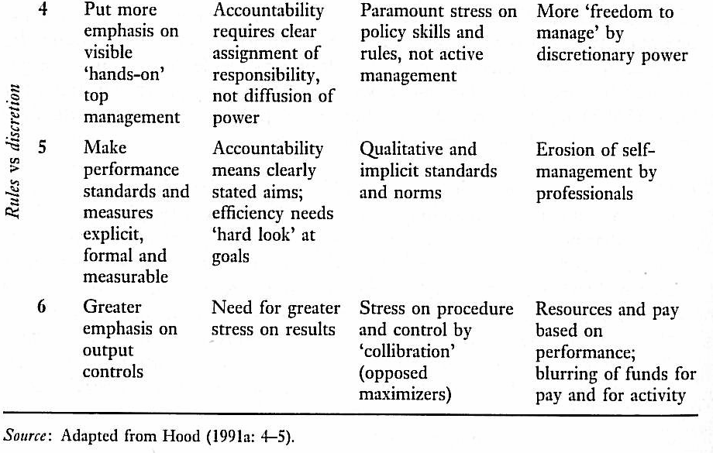

Slide 8
Session 2: Actors in health care systems
Actors and agency relations in health systems.
Health professions, organizations and power.
Essay: What are the main factors that help understand
the power of the medical profession?
Required reading:
Blank, R.H.; Burau, V. 2007. Comparative health policy. 2nd ed. Ch.5, pp. 131-158. [PDF]
Optional reading:
Ferlie, E. et al. 1996. (eds.) The new public management in action. Oxford: Oxford University Press. Ch. 7, pp.165-194.
Johnson, T.; Larkin, G.; Saks, M. 1995. (eds.) Health professions and the state in Europe. London: Routledge.
Kickert W. and Klijn, E. 1997 (eds.) Managing complex networks. London: Sage, pp.14-61.

Slide 9
1. Actors and agency relations in health systems.
1.1. Why reform health care?
1.2. How to reform it?
1.3. Actors in health care markets

Slide 10
1.1. Why reform health care? (I)
Problems common to all health system models
  Inequity of access to services, of resource distribution, and of health states/levels between groups and regions (waiting lists…)
  Increase in health expenditure without an impact on the population health state (pressures from both demand and supply sides)
  Inefficiency: variability in medical activity and costs; poor coordination between health care levels (primary and specialized)

Slide 11
1.1. Why reform health care? (II)
  Citizens’ dissatisfaction with impersonality and bureaucracy in service delivery
  Third-party payer (mal)functions:
    Insurance/coverage: assumption of health financial risk
    Access: to health services by the population
    Agency: intelligent buyer on behalf of its principal

Slide 12
1.2. How to reform it?
“New public management”
  Incentives: focus on performance measurement and link to remuneration
  Disaggregation: quasi-autonomous, single function- organizations (regulation, financing, purchasing, provision…)
  Managed competition on the basis of contracts: quasi-markets
  Quality and citizens orientation

Slide 13
1.3. Actors in health care markets (I)
Health markets involve agency relations between:
  Insurers P/A
  Purchasers A/P
  Providers P/A
  Professionals A/P
  Citizens P/A

Slide 14
1.3. Actors in health care markets (II)
Contractual relation: hard vs soft contract
  Principal’s challenge: to design an incentive structure that induces the agent to work for the principal’s interest.
Information asymmetry:
  Ex-ante problem: inobservability of information (Adverse selection)
  Ex-post problem: inobservability of behaviour (moral hazard)

Slide 15
Exercise
Actors interests / preferences:
  Politicians
  Insurers
  Providers:
    Owners
    Managers
    Professionals
  Citizens
Private sector vs public sector management?
  Values
  Aims
  Decision-making (-ers)
  Evaluation criteria
  Property rights
  Responsibility/accountability rules

Slide 16
2. Health professions, organization and power
2.1. Professions and professional bureaucracies
2.2. Quasi-markets, hierarchical contracts and relational markets

Slide 17
2.1. Professions (I)
Profession: occupational group sharing:
  Expert knowledge
  Code of ethics
  Vocation
  Identity professional power
  Social status
  Self-regulation
  Loyalty

Slide 18
2.1. Professions (II)
Conflict of logics - simultaneous participation in two systems:
    The profession: expert knowledge, code of ethics, identity, self regulation, autonomy of decision…=>saving lives.
    The organization: management instruments, hierarchical control, procedure protocols, organizational norms and regulations…=> being cost-effective/ efficient/ economic

Slide 19
2.1. Professional bureaucracies (III)
Realization activities and achievement of purposes depend on professional employees’ competence –operating core.
NPM -erosion of self-management and clinical autonomy in favour of managerial authority (economy and efficiency)
Professionals - high degree of autonomy in their work, aim to control the administrative middle line of the organization
Standardization of skills and knowledge is the main coordinating mechanism, but is largely originated outside the organization by self-governing collegial associations.
Work processes are too complex to be standardized by analysts or supervised by managers, and the outputs of professional work cannot easily be measured and thus standardized.

Slide 20
2.2. Conditions for quasi-markets to succeed
Market structure: the structure on both sides of the market (SS and DD) should be competitive, nevertheless, when a monopoly exists on one side, a monopoly on the other side may be needed as a countervailing power,
Information: both providers and purchasers need to have access to accurate, independent information, the former primarily about costs, the latter about quality,
Transaction costs associated with uncertainty should be kept to a minimum
Motivation: providers should be motivated to some extent by financial considerations, and purchasers by the welfare of users.
Cream-skimming: no incentives should exist for purchasers to discriminate between users in favour of the least expensive.

Slide 21
2.2. Hierarchical contracts (I)
Solving hierarchical problems by contractual means requires building "hierarchical elements" into contracts:
  command structure and authority system - whereby communication flows are certified as legitimate or authoritative.
  incentive systems - performance measures according to which differential reward can be allocated without recourse to the market.
  standard operating procedures - which describe routines to be followed by both clients and contractors in their actions.
  dispute resolution procedures -which are isolated to a certain extent from the court system and the market.
  non-market pricing usually based on contractor costs is to value variations in performance.
Aim: to serve as the regulations a formal organisation would have written in its constituent documents, by incorporating elements of the client and the contractor organisations into a new unity under circumstances where theory would predict vertical integration.
Uncertainty - too many contingencies to be predicted in advance, "hierarchical contracts" provide that contractual stipulations may be changed by specific methods. Uncertainties derive from:

Slide 22
2.2. Hierarchical contracts (II)
Uncertainty - too many contingencies to be predicted in advance (even more in health!):
Performance (activity, output, outcome)
  measurable
  observable (monitoring, ex-post control and evaluation, accountability)?
Costs – not accurately predictable because of
  contractor technical or cost uncertainty
  client ignorance
  commercial or legal uncertainty in the client-contractor relation
Client or contractors wanting to change specifications.

Slide 23
2.2. Hierarchical contracts (III)
What has to be binding under such circumstances is the overall control of the incentive system by one of the parties:
        Who is the principal?
        Who is in charge?
        Participation

Slide 24
2.2. Relational markets
Between hierarchies and markets: network management
Bi/multi-laterals relations of power/colaboration/mutual dependency based on long-term trust (historically, socially and personally intersected)
Emergence of relational markets is more probable when benefits from transactions are higher than costs.
Conditions:
  Actors involved control complementary resources.
  Network boundaries are clear.
  Frequent and high quality transactions.

Slide 25
Concluding comments
Who is in charge?
What tools?
What/whose values?
What/whose ethics?

