Slide 1

Master in Health Economics and Policy
Ethics and Health
(April 10-June 19, 2012)
Marc Le Menestrel
marc.lemenestrel@upf.edu
Raquel Gallego
raquel.gallego@uab.cat

Slide 2
Session 3: The politics of health care networks.
  1. Multi-level governance of health care: issues and evidence.
  2. Strategy building: The case of the “Catalan health care model”.
  Essay: What sort of issues rise from the devolution of welfare policies?
  How does devolution challenge the concept of welfare state?
Required reading:
Gallego, R.; Gomà, R.; Subirats, J. 2005 “Spain: from state welfare to regional welfare”, in McEwen, N.; Moreno, L. (eds) The territorial politics of welfare. London: Routledge. [PDF]
Gallego, R. and Subirats, J. 2011. “Regional welfare regimes and multilevel governance” in Guillén, A.M. and León, M. (eds.) The Spanish welfare state in European context, London: Ashgate.
Optional reading:
World Health Organization. 2010. Health Systems in transition. Spain. Vol.12:4. (http://www.euro.who.int/__data/assets/pdf_file/0004/128830/e94549.pdf)
Gallego, R. 2000 “Introducing purchaser/provider separation in the Catalan Health Administration: A budget analysis”, Public Administration –An international quarterly, 78(2):420-439.
Gallego, R.; Subirats, J. 2005 “Spain: from state welfare to regional welfare”, in McEwen, N.; Moreno, L. (eds) The territorial politics of welfare. London: Routledge.

Slide 3
  1. Multi-level governance of health care: issues and evidence.
1.1. Devolution and policy divergence in
Spain: First stage of the research.
1.2. Devolution and policy divergence in
Spain: Second stage of the research.

Slide 4
1.1. Devolution and policy divergence (I)
First stage of the research program:
Gallego, R.; Gomà, R.; Subirats, J. (eds) 2003. Estado de Bienestar y Comunidades Autónomas. La descentralización de las Políticas Sociales en España. Madrid: Tecnos-UPF.
Gallego, R.; Subirats, J. 2005 “Spain: from state welfare to regional welfare”, a McEwen, N.; Moreno, L. (eds) The territorial politics of welfare. London: Routledge.

Slide 5
1.1. Devolution and policy divergence (II)
Analytic interest:
‘Welfare state’ vs ‘welfare regime’
‘State government’ vs ‘multilevel government’
Empirical interest:
Simultaneous processes: devolution and wefare state building
Research questions:
Has self-government led AA.CC. to take different welfare policy options?
If so, in what sense do their options differ?

Slide 6
1.1. Devolution and policy divergence (III)
Dimensions of comparison:
Substantive dimension: what to do? what needs to cover? with what intensity and extension?
  Public vs private model
  Homogeneous vs differential
Operational dimension: how to do it?
  Management tools
  Actors and networks

Slide 7
AA.CC. and policy domains
Health and Education:
  Catalonia, Andalusia, Basque Country, Valencian Community in the 80s
  Galicia, Navarre, Cannaries first half of 90s
Housing and social services:
  All AA.CC. in the 80s.
Employment:
  Catalonia in the 90s, followed by the rest in different moments.
Minimum Income:
  Policy difusion among AA.CC. over the 90s, with specificities.

Slide 8
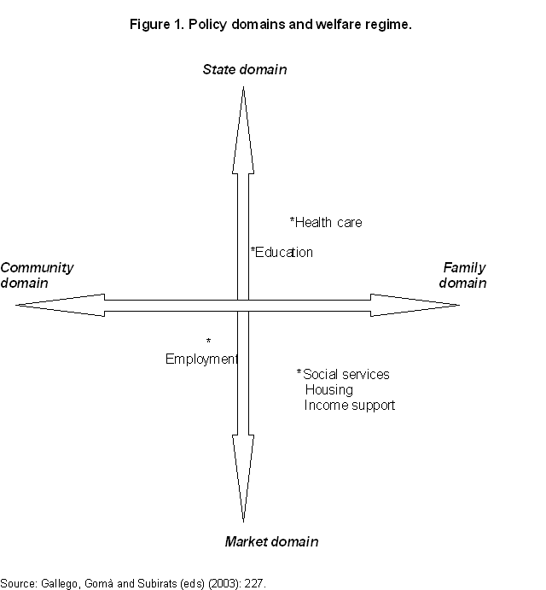

Slide 9
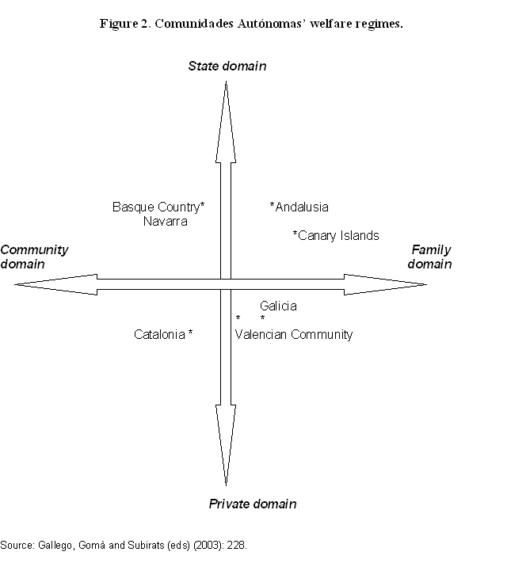

Slide 10
1.2. Devolution and policy divergence (I):
Second stage of the research program:
Gallego, R. and Subirats, J. (coord.) 2011. Autonomies i desigualtats a Espanya. Percepcions, Evolució Social i polítiques de benestar. Barcelona: Institut d’Estudis Autonòmics.
Gallego, R. and Subirats, J. 2011. “Regional welfare regimes and multi-level governance” in Guillén, A.M. and León, M. (eds.) The Spanish Welfare State in European Context. Farnham: Ashgate.

Slide 11
1.2. Devolution and policy divergence (II)
Research question:
Has devolution led to an increase in inequality in Spain?
  Analysis of perceptions (17 discussion groups)
  Statistical analysis of social and structural indicators
  Analysis of education, health and social services policies: Discoursive, substantive and operational dimensions.

Slide 12
Perceptions

Slide 13
Perceptions about health policy

Slide 14
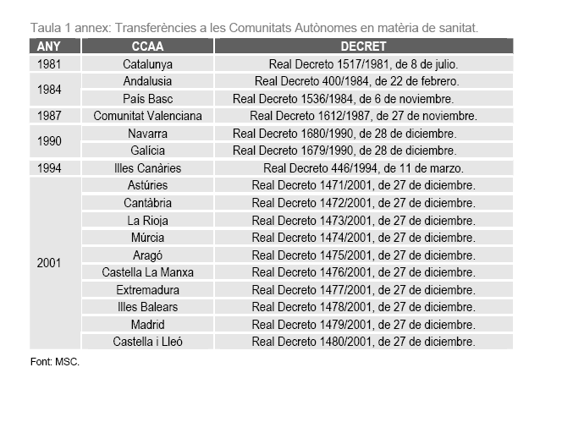
Health transfers calendar

Slide 15
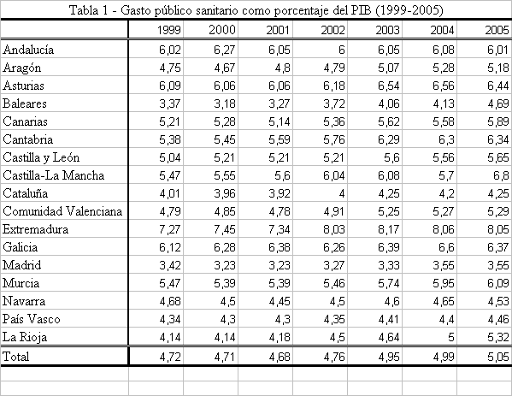
Health public expenditure as a percentage of GPD

Slide 16
Health public expenditure as a percentage of GDP

Slide 17
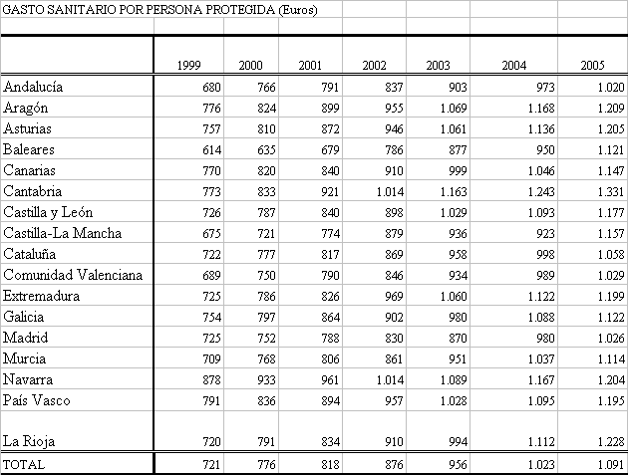
Health public expenditure per capita

Slide 18
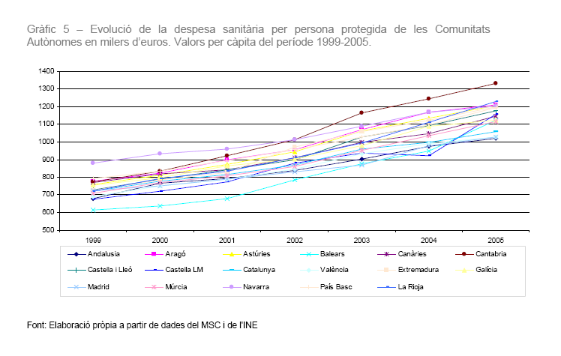
Health public expenditure per capita

Slide 19
Catalogue of services provided

Slide 20
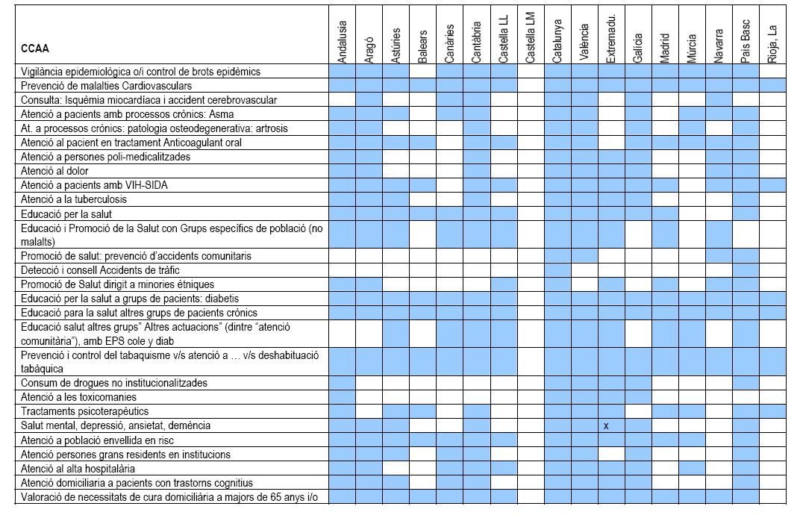

Slide 22
Institutional form of health authority

Slide 23
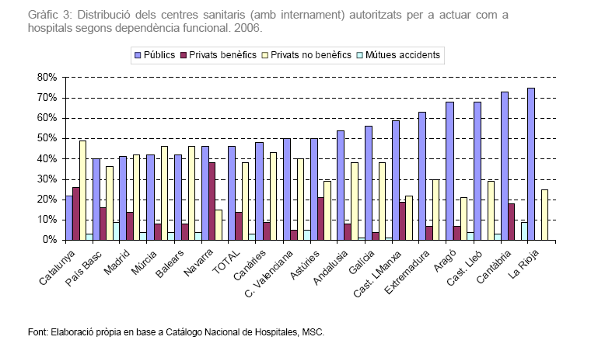
Type of ownership of health providers

Slide 24
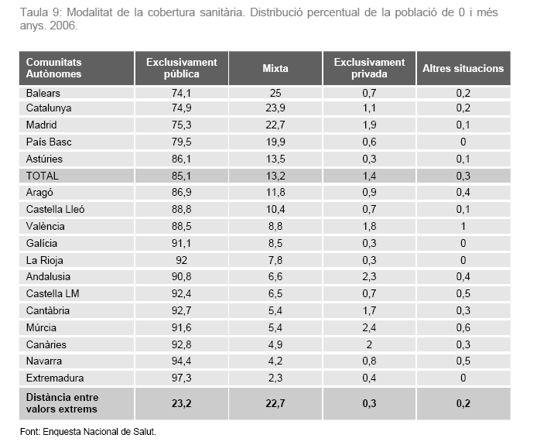
Health coverage financing

Slide 25
Degree of differentiation in health policies
Degree of differentiation/ Innovation | Discoursive/ symbolic dimension* | Substantive dimension** | Operational dimension***
High | Catalonia Navarre Basque Country Galicia | Navarre Aragon Castile and Leon Extremadura | Catalonia Valencia Balearics Madrid
Medium | Balearics Valencia Aragon Castile and Leon Andalusia Cantabria | Balearics Basque Country Catalonia Galicia Cantabria La Rioja Asturias Canaries Castile-La Mancha | Galicia Castile and Leon Basque Country Canaries Andalusia Asturias
Low | La Rioja Madrid Asturias Canaries Murcia Castile-La Mancha Extremadura | Madrid Andalusia Valencia Murcia | Navarre Castile-La Mancha La Rioja Murcia Cantabria Extremadura Aragon

Slide 26
Indicators
*Normative dimension: pace and scope of legal acknowledgement of new health rights.
**Substantive dimension: per capita public expenditure, per capita primary care resources (centres and personnel), and per capital hospital care resources (beds).
***Operational dimension: weight of indirect provision within the publicly financed health system. ‘Low’: direct public provision is prevalent. ‘Medium’: indirect public provision is increasing. ‘High’ both private and public indirect provision tends to prevail.

Slide 27
  2. Strategy building: The case of the “Catalan health care model”.
2.1. Spanish health care model
2.2. Catalan health care model

Slide 28
2.1. Spanish health care model
Democratization:
  1978 Constitution: art.43 Right to health protection
  1982 PSOE’s commitment to a NHS model (INSALUD)
Welfare state and devolution:
  1986 GHL: universal coverage, state budget financing, role of primary care, integrated model
  AA.CC. as managers and providers of welfare: Catalonia (1981), Andalusia (1984), Basque Country and Valencian Community (1987), Navarre and Galicia (1990), Cannaries (1994), the rest (2001)

Slide 29
Financing sources of the INSALUD’s budget: State contributions and SS contributions, 1986-97.

Slide 30
Structure of public health expenditure in Spain,1982-90 (in percentages).

Slide 31
Health reforms in Spain, 80s-90s (I)
Regional health services
  Primary care
  Health plans
  Hospital ownership and financing
  Legal nature of health authority

Slide 32
Health reforms in Spain, 80s-90s (II)
NPM tools in the INSALUD:
  1991 Abril report
  1992-… Program-Contracts, prospective budgeting, activity measures, viability plans
  Evaluation of medical technology – central and some regional governments.
  1996, 1997- legal measures to enable diversification of management forms
  1998: Public foundations

Slide 33
2.2. Catalan health system: managed competition policy tools
Hospital accreditation system (1981)
Creation of the Hospital Network of Public Utilisation (1985) (18,000 beds from a total of 33,000)
Generalisation of price and activity measures-based contracts between health authority and public (except for Social Security providers), semi-public and private hospital providers (1982, 1986,1989…)
Rationalisation of the hospital network by joining up public and private efforts (1986-)
Institutional separation between purchaser and providers affecting both hospital and primary care (1990, 1992, 1997, 2001)
CHI (SS provider) => public enterprise (2007)….split?

Slide 34
Investment on health care by the Catalan government, 1982-95 (indexed 100 in 1982).

Slide 35
Percentage of health budget spent on contracts with non-CHI providers, 1982-95

Slide 36
Hospital beds available in Catalonia and the rest of Spain
Ownership | Catalonia (% of total number of beds) | Rest of Spain (% of total number of beds)
TOTAL PUBLIC | 41 | 75
Social Security | 12 | 38
Others | 29 | 37
TOTAL PRIVATE | 59 | 25
Non-charitable | 30 | 14
Charitable | 29 | 11
TOTAL | 100 | 100

Slide 37
Catalan health care system pre-1990
Financing Purchaser Providers
and provider
Budget Contracts
DHSS Catalan Health HNPU
Institute
Integrated hierarchy
of corporate centre and
Social Security hospital
and primary care providers

Slide 38
Catalan health care system post-1990
Financing Purchaser Providers
Budget Contracts
DHSS Catalan Health HNPU
Service Catalan
Health
Institute
(SS prov.)

Slide 39
Success factors
Priority on the general and specialized regional agenda.
Consensus building process among political (regional and local) and managerial interest coalitions
Involvement of key actors affected in the formulation of the health system model
Political and economic commitment to the survival of all interests/providers involved (positive-sum game)
Relational market instead of quasi-market:
  High quality relations
  Stable network (number and identity of actors)
  Adaptation through bilateral negotiations for mutual interest
  Mutual resource dependence among actors

Slide 40
Failures? (I)
Policy displacements
  Functional collusion between purchaser and providers
  Purchaser interventionism in providers
  Purchaser’s commitment to providers’ economic survival
  Allocation of the purchaser role to a provider in the health region of Barcelona City.

Slide 41
Failures? (II)
Implementation deficit
  CHS behaves as a financer rather than as a purchaser
  CHS performs functions of planning, financing, regulation and arbiter
  CHS corporate center concentrates these functions to the detriment of health regions
  Incentive structure of the contractual system:
    Under-funding
    Program-contracts
    Financing sources external to main price and activity-based system.

Slide 42
Failures? (III)
Unintended consequences
  Increasing publicness of all providers:
    Dependence on public financing sources
    Health authority’s commitment to providers economic survival
    Low level of providers’ autonomy
    Low level of health authority’s autonomy

Slide 43
Conclusions
What can be learned from implementation gaps?
To what extent is NPM a solution to health systems’ problems?
Is this all about management or about politics?
…and isn’t politics about ethics?

