Slide 1

Master in Health Economics and Policy
Ethics and Health
(April 10-June 19, 2012)
Marc Le Menestrel
marc.lemenestrel@upf.edu
Raquel Gallego
raquel.gallego@uab.cat

Slide 2
Session 4: Policy making:
Problem definition and power.
  What is a problem? What sort of ideas become problems?
  What is power? Who is powerful?
Essay: What is a problem from a policy analysis perspective?
Give an example.
Required reading:
Dery, D. 1984. Problem Definition in Policy Analysis, University Press of Kansas, Ch.2-3, pp.14-36. [PDF]
Optional reading:
Dowing, K 1996. Power. Buckingham: Open University Press
Loseke, D.R. 2003. Thinking about social problems. London: Aldine Transaction.

Slide 3
Policy cycle
Problem Agenda- Decision- Implementation
Definition Setting Making
Simbolic
dimension
Epistèmic
Conflicts
Style
Dimension
Interaction
models
Fundamental
choice
SubstantiveDimension
Management
scenarios
Operational Dimension
Source: Adapted from Gomà and Subirats, 1998

Slide 4
Problem definition (I)
“Where to build a highway?”
  →Better to ask how to design a consultation and negotiation procedure to help decide where to build it.
  (Do we need a highway?...)

Slide 5
Problem definition(II)
Problem: Substantial discrepancy between what it is and what it should be:
  (+) does not identify problem with insatisfactory situation
  (+) there’s no problem where there’s no insatisfaction
  (+) there’s no insatisfaction where there’s no aspiration for improvement
  (-) desired state may not be attainable
  (-) if desired state is taken as constant, only present conditions may be manipulated

Slide 6
Problem definition (III)
Different solutions assume different problems:
  It’s important to choose the right objective
  Choosing the wrong objective involves solving the wrong problem
  Chooing between different objectives involves choosing between different problems

Slide 7
Problem definition (IV)
Analytical construct
  Problem vs objective situation
  Who defines a situation as a problem?
  Whose problem definition will prevail?
Qualified relativism:
  Instrumental solution
  Interventionist perspective
  Improvement

Slide 8
Problem definition (V)
Problem =situation=causes
  Causality chain?
Defining a problem:
  Identifying a discrepancy that can be overcome (between what it is and what it should be)
  Identifying the map/trajectory to go from what it is to what it should be
  Conceivable solution: net benefit in relation to the previous situation

Slide 9
Problem definition (VI)
Problem = opportunity of improvement
Criteria for choosing between alternatives
  Net benefit
  Pareto, Kaldor & Hicks
  Technological and political viability

Slide 10
The role of analysis
“Expert” definition vs “democratic” definition of problems
Limitations of “scientific/expert” analysis
Ideological analysis

Slide 11
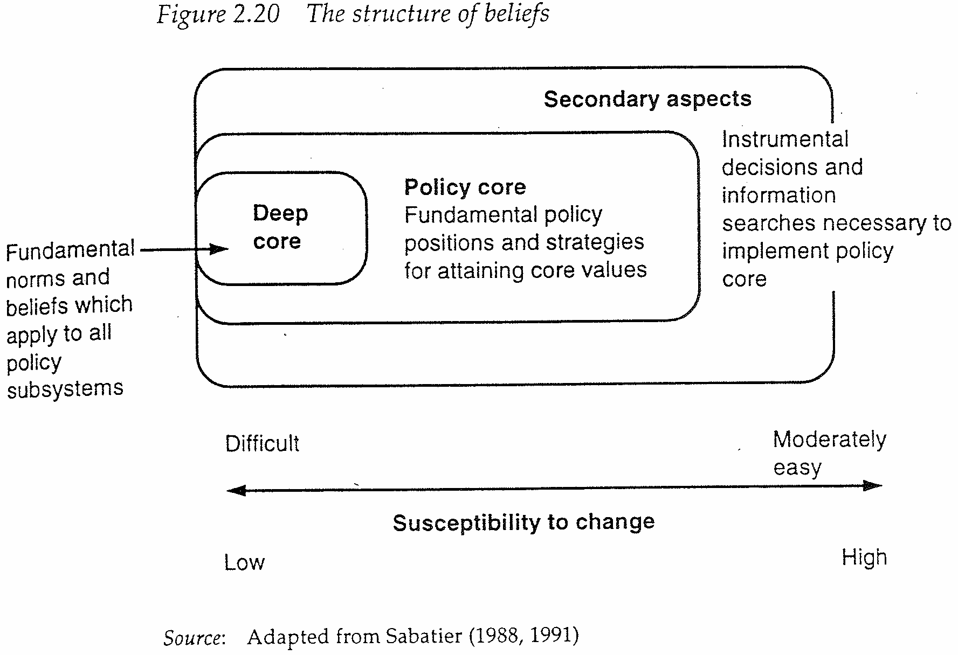
Advocacy coalition theory

Slide 12
Actors and power (I)
Politics: collective activity that pursues the regulation and management of social conflict through binding decisions (component of compulsion or imposition => idea of power)
Power: capacity to intervene in this activity
Question: who gets what, when, how and why?
  Pluralist approach
  Elitist approach

Slide 13
Actors and power (II)
The capacity to successfully negotiate depends on the use of your resources:
  Expert knowledge
  Information
  Legitimate autority (legal, expertise, knowledge)
  (Un)conditional incentives
  Reputation
Context, preferences, resources and stances of alies and opponents.

Slide 14
Actors and power (III)
Power: “getting what you want” vs “getting what you want even against others’ preferences”
Luck: probability of getting what you want without trying
Success: probability of getting what you want if you try.
Luck+ Being decisive = Success
Luck= Success – Being decisive

Slide 15
Actors and power (IV)
Luck
Fortunate Unfortunate
Success
Successful 1 2
Unsuccessful 3 4

Slide 16
Actors and power (V)
Some are systemically lucky: they get what they want without trying because of how society is structured.
While power is based on the use of specific social resources for negotiation, luck is based in the social position of individuals or groups.
Exemple: the capital’s systemic luck (Przeworski -’The valley of transition’).

