Slide 1
Master in Health Economics and Policy Ethics and Health (April 10-June 19, 2012)
Marc Le Menestrel
marc.lemenestrel@upf.edu
Raquel Gallego
raquel.gallego@uab.cat

Slide 2
Session 5: Agenda setting and policy decision making.
Where does policy come from? Which and whose interests influence policymaking?
Case: Swine flu.
Essay: Use an example to analyse how an issue is included
on the agenda and how it is brought to a decision stage.
Required reading:
Colebach, H.K. 2005. Policy. Buckingham. Open University Press. 2nd edition. Ch. 3-4, pp.22-48. [PDF]
Swine Flu case. [PDF]
Optional reading:
Colebach, H.K. 2005. Policy. Buckingham. Open University Press. 2nd edition. Ch. 5-6, pp.49-81.
Smith, K.; Larimer, C. 2009. The Public Policy Theory Primer, Westview Press, pp.49-99.

Slide 3
Policy cycle
Problem Agenda- Decision- Implementation
Definition Setting Making
Symbolic
dimension
Epistemic
Conflicts
Style
Dimension
Interaction
models
Fundamental
choice
SubstantiveDimension
Management
scenarios
Operational Dimension
Source: Adapted from Gomà and Subirats, 1998

Slide 4
Cycle model
Ordering and
Interpreting
Case Evidence
Prior Events
Contemporaneous Events
Later
Events
Focusing Events
The Episode
Policy Cycle
Elections
Transitions
Agenda setting
Decision-
making
Imple-
mentation
Alternative specification
Related Events
t
Source: John Kingdon, Agendas, Alternatives, and Public Policies

Slide 5
Agendas (I)
Systemic/public agenda
Institutional/policy agenda
Mechanisms connecting agendes: issue inclusion or exclusion

Slide 6
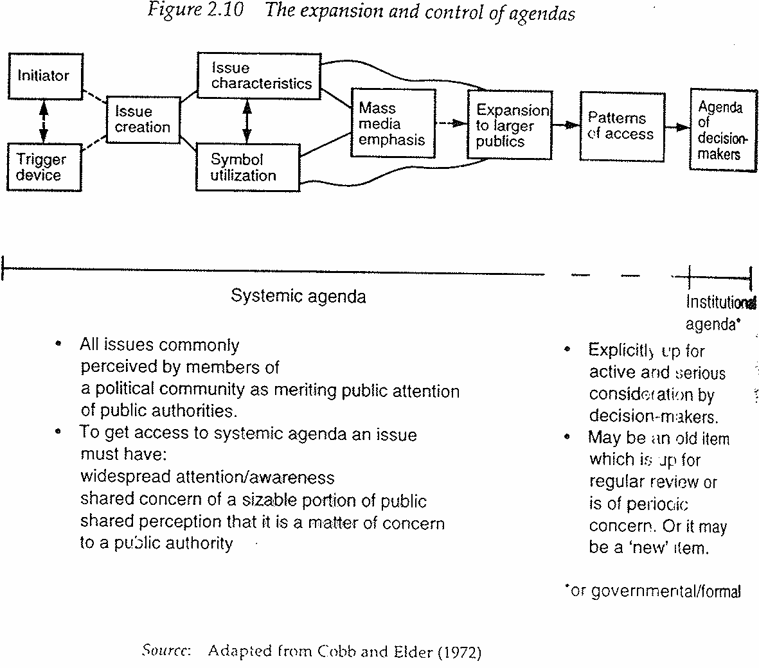
Agendas (II)

Slide 7
Agendas (III)

Slide 8
Agenda setting and power (I)
Dimensions of power (Lukes, 1974):
First dimension
Second dimension
Third dimension

Slide 9
Agenda setting and power (II)
First dimension of power:
Open conflict (observable)
Choosing between alternatives
Explicit issues on the agenda
Preferences revealed via participation
Subjectives interests expressed
Sincere behaviour (reflecting those interests)
Power: contribute to a decision that makes your preferences prevail

Slide 10
Agenda setting and power (III)
Second dimension of power:
Half-open conflict (observable)
‘Non-decision’- decisions that try to prevent latent conflicts from becoming open conflicts
Explicit, articulated and observable preferences
Subjective interests expressed
Sincere behaviour (reflecting those interests)
Power: controlling issue access to the agenda (non-decisions)

Slide 11
Agenda setting and power (IV)
Third dimension of power:
Situation in which somebody is having her/his interests objectively harmed, but she/he does not conceptualize it as unsatisfactory
Power: capacity to manipulate perceptions, information and preferences to prevent the acknowledgement of latent conflicts between the interests of dominant groups and the interests of the rest
Actions by a group may not be assigned to decisions and behaviors by individuals
There may be systemic and organizational biases

Slide 12
Agenda setting and decision making (I)
Kingdon’s model (1984)
Political stream
Problem stream
Policy stream
Policy choices

Slide 13
Agenda setting and decision making (II)
Baumgartner and Jones’s model (1993)
Issue image
Domain structure
Policy subsystem

Slide 14
Decision making (I)
Model | Decicion maker | Choice criteria
Rational | Unitary | Optimization
Limited rationality | Unitary/coalition | Satisfaction
Incremental | Interdependent actors | Compromise
Garbage can | Changing | Random/Chance

Slide 15
Decision making (II)
 | Objectives
Effects | Clear | Unclear
Clear | Technological solution (Rational method) | Political decisions (Incremental method)
Unclear | Experimental solution (Limited rationality) | Inspiration (Garbage can method)

Slide 16
Policies and arenas (I)
Benefits
Concentrated Difuse
Costs
Concentrated Redistributive Regulative
Difuse Distributive Institutional
Lowi ’64, Wilson ’80, Majone ‘96

Slide 17
Policies and arenas (II)
Excludable Non-excludable
Consumption
Private Pool
Divisible goods goods
Indivisible Toll Public
goods goods
Savas ’87

Slide 18
Policies and arenas (II)
Excludable Non-excludable
Consumption
Private Pool
Divisible goods goods
Indivisible Toll Public
goods goods
Savas ’87
Merit
goods

Slide 19
Case study
Question for “Swine Flu”:
Briefly characterize the situation
Identify the main actors (key resources?)
What are the main problem definitions they make?
Who controls whose agenda?
Does this case fit a particular decision-making model?

